Slide 1
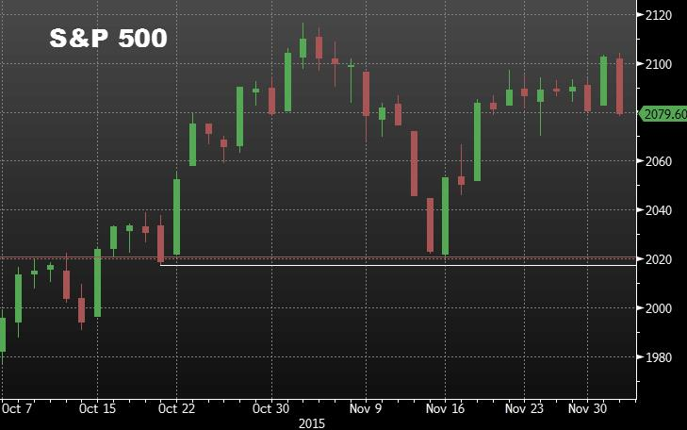
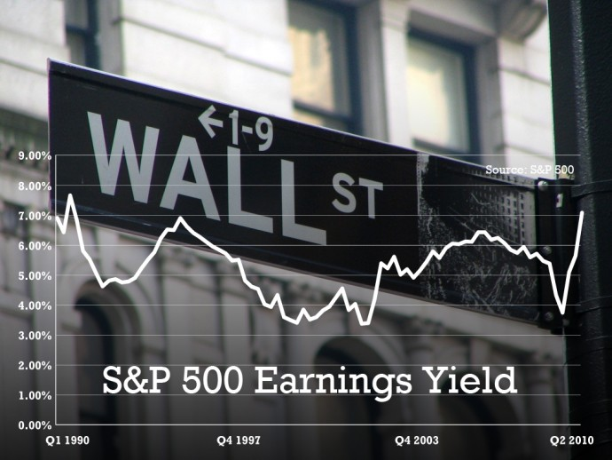
Win The Market
By Haosu Tang,
Chengcheng Qin,
Kevin Qi
Notes:
For our final project, we set out to see if we could find patterns and make accurate predictions on the S&P500 index. The S&P500 index is essentially a basket of the 500 most influential stocks on the NYSE and NASDAQ. It is considered one of the best representations of the US stock market.

Slide 2




Introduction
Exploratory Data Analysis
Time Series Analysis
Trend Fitting
Machine Learning Analysis
Notes:
The methods we used in our project include exploratory data analysis, time series, trend fitting, and machine learning. But before conducting any analysis, we first have to gather the data we will use to train our classifiers.
///
The data we used is mostly freely available and easy to access from APIs. The data we used for technical analysis is mainly from financial data providers such as Bloomberg, Quandl, and Yahoo Finance. For trend fitting, we grabbed our data from the Federal Reserve Bank’s website.

Slide 3
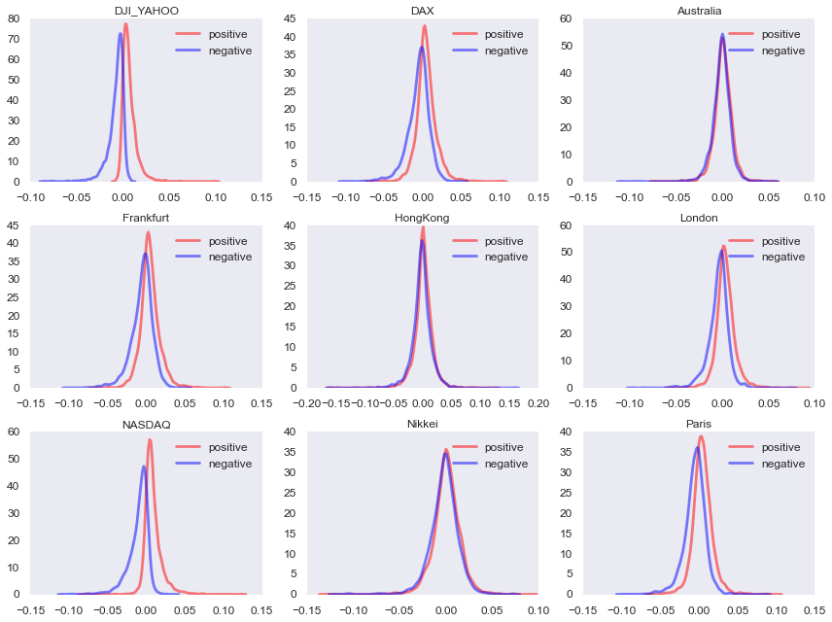
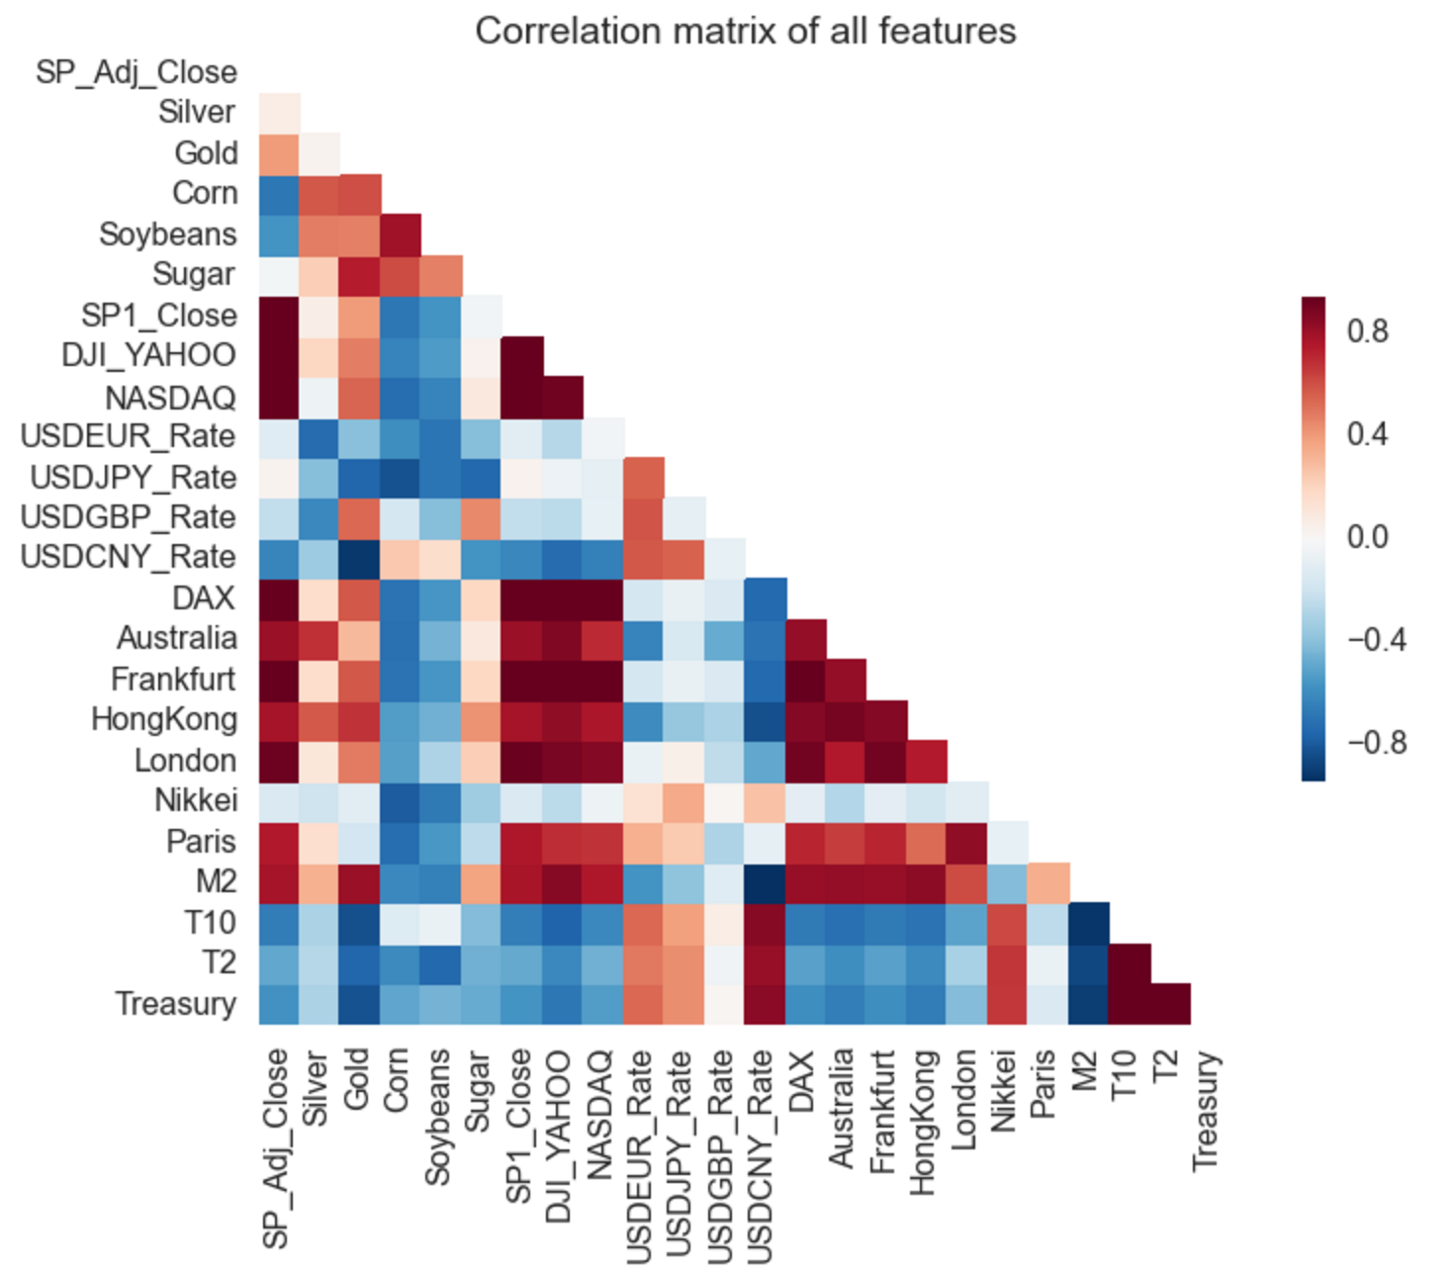
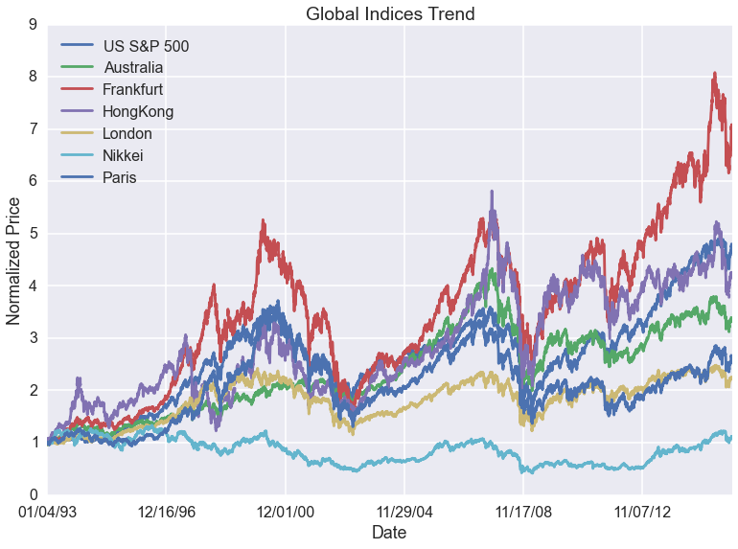
Exploratory Data Analysis
Notes:
After data cleaning and collecting, we plot our initial data and try to find patterns and correlations between them. First we created a correlation matrix and found that S&P500 index is highly correlated with other indices in other countries. Then we plotted the trends of global markets and the distribution of the SP500 with other international indices. We found four that we thought could predict the price of SP500.

Slide 4
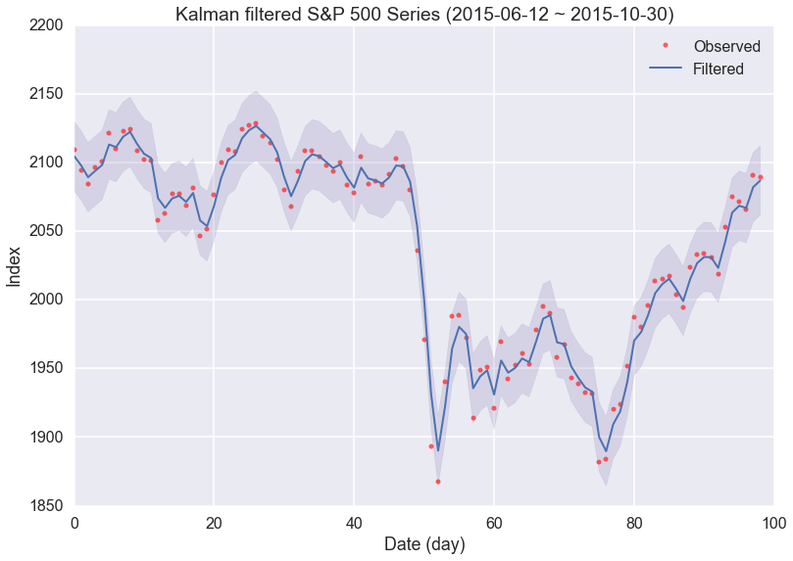
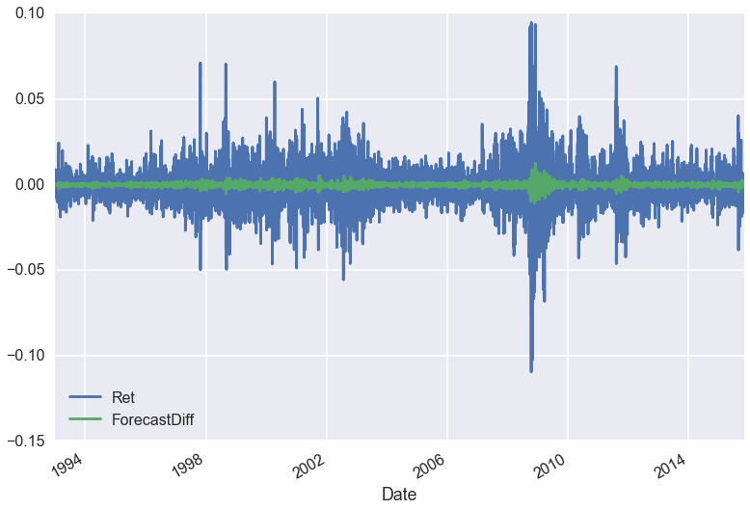
Time Series Analysis
Notes:
Here we performed time series analysis with arima and Kalman filter to fit the daily data.

Slide 5
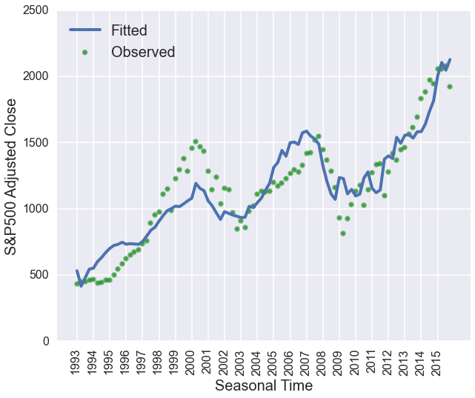
Trend Fitting
CPI
PPI
Real GDP
M1
T10-T2
Notes:
We also used CPI, PPI, real GDP, Money Supply, and Treasury Bond Yields Spread to fit the quarterly data. After fitting, we are left with features that we can use to make predictions.

Slide 6
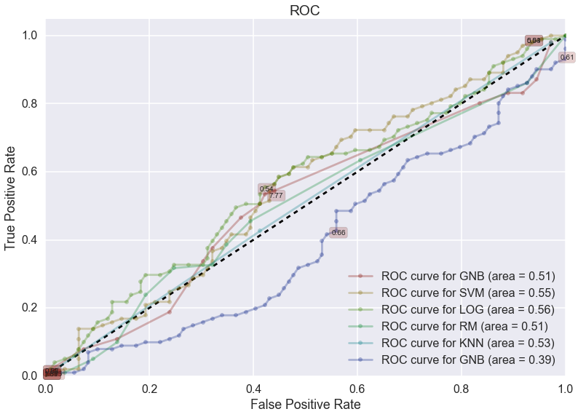
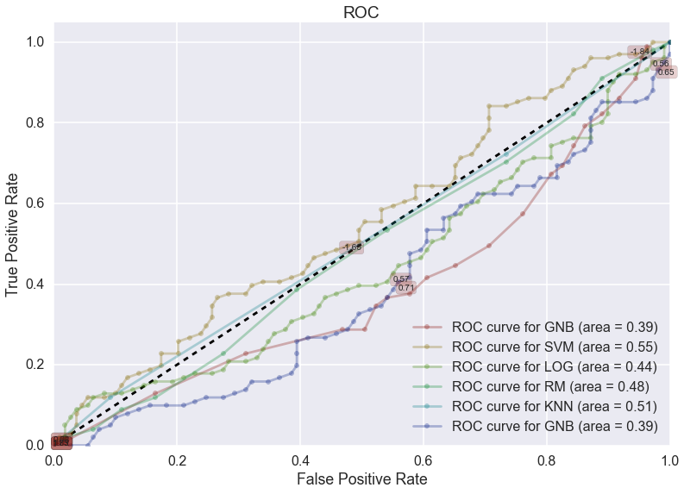
Machine Learning Analysis
Notes:
We used SP500 historical data and futures to predict SP500’s movement and did marginally better if not worse than a flip of a coin.

Slide 7
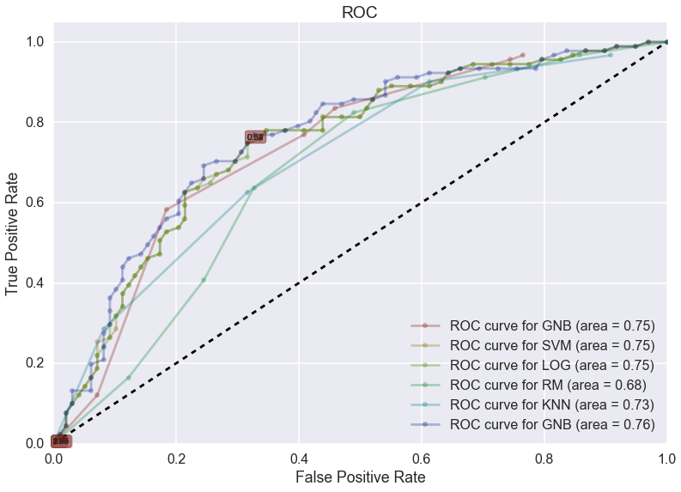
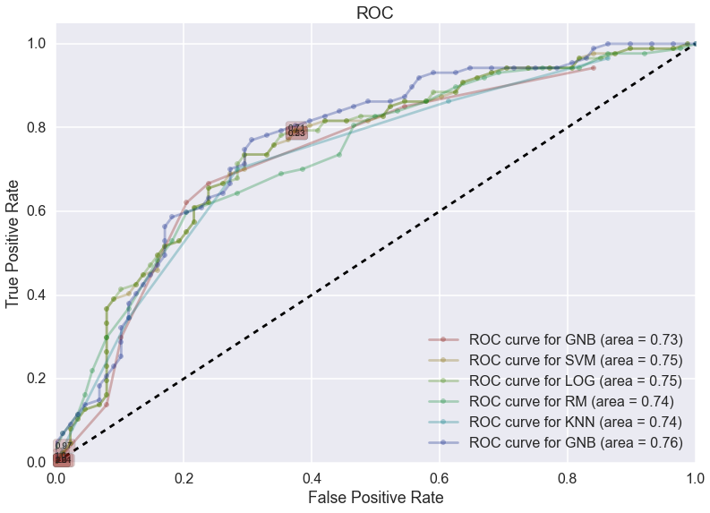
Machine Learning Analysis
Notes:
Here we used global indices and currency exchange rates to predict the next day's SP500 closing price. Surprisingly, the area under our ROC auc ranges from 73 to 75%. Remember the four indices we said were important before? Well, if we only use them, we still get a high accuracy.

Slide 8


Win the market
Notes:
In conclusion, we applied different methods to fit and predict the sp500 index. Both time series and quarterly trend analysis can give us an initial sense about sp500’s trend. Using different classifiers and predictive features offers more than 70% accuracy. But, can we really win the market? As of now, we have no persuasive answer since our models assume the market is unchanged.

